Slide 1

Resilience Planning and how the empire strikes back
Bhakti Mehta
@bhakti_mehta

Slide 2
Introduction
Senior Software Engineer at Blue Jeans Network
Worked at Sun Microsystems/Oracle for 13 years
Committer to numerous open source projects including GlassFish Application Server
Notes:
A little bit on my background beforre we begin. I am currently a senior sw engineer at BJN
I worked at Sun Microsystems for 10 and Oracle for 3 years
I m a committer in numerous open source projects most notable of them is gf

Slide 3

My recent book

Slide 4

Previous book

Slide 5
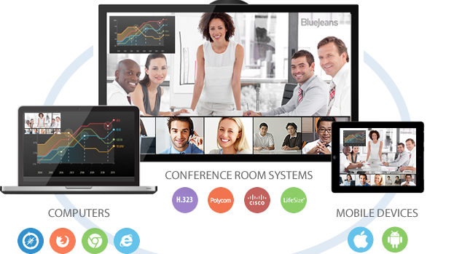
Blue Jeans Network
Notes:
Whats up with the name? if you think my name was sassy my employer is better than me
They want video conferencing to be as ubiquitous and widely used as a favorite pair of jeans
We do video conferencing in the cloud
As this picture suggests we support various devices, room systems, mobile offering and desktop options too
ustomers in the space of client services, education, entertainment, IT healthcare legal It is a cloud based service for content sharing video sharing collaborationonference room video systems, most companies have desktop software like Microsoft Lync or Cisco Jabber for internal chat and video. Employees also bring mobile devices to work. Blue Jeans enables all of these devices and services to connect to the same video meeting for simple, any-device collaboratio imple scheduling, including integration with Microsoft Outlook and Google Calendar
Click to join meetings from email invitation
Intuitive in-meeting controls to mute/unmute, share/view content, change layouts, view participants

Slide 6

Blue Jeans Network
Video conferencing in the cloud
Customers in all segments
Millions of users
Interoperable
Video sharing, Content sharing
Mobile friendly
Solutions for large scale events

Slide 7
What you will learn
Blue Jeans architecture
Challenges at scale
Lessons learned, tips and practices to prevent cascading failures
Resilience planning at various stages
Real world examples

Slide 8
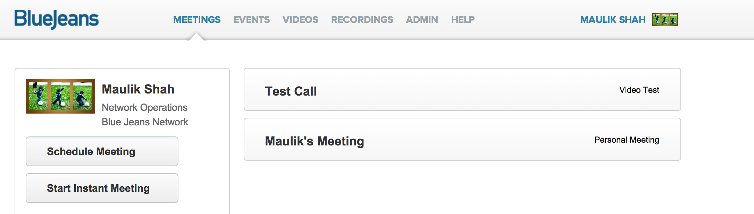
Top level architecture
Web Server
Proxy layer
DB
Middleware services
Cache
Customer B
Service discovery
Messaging
INTERNET
Customer A
Media Node
Connector Node
SIP, H.323
HTTP / HTTPS

Slide 9
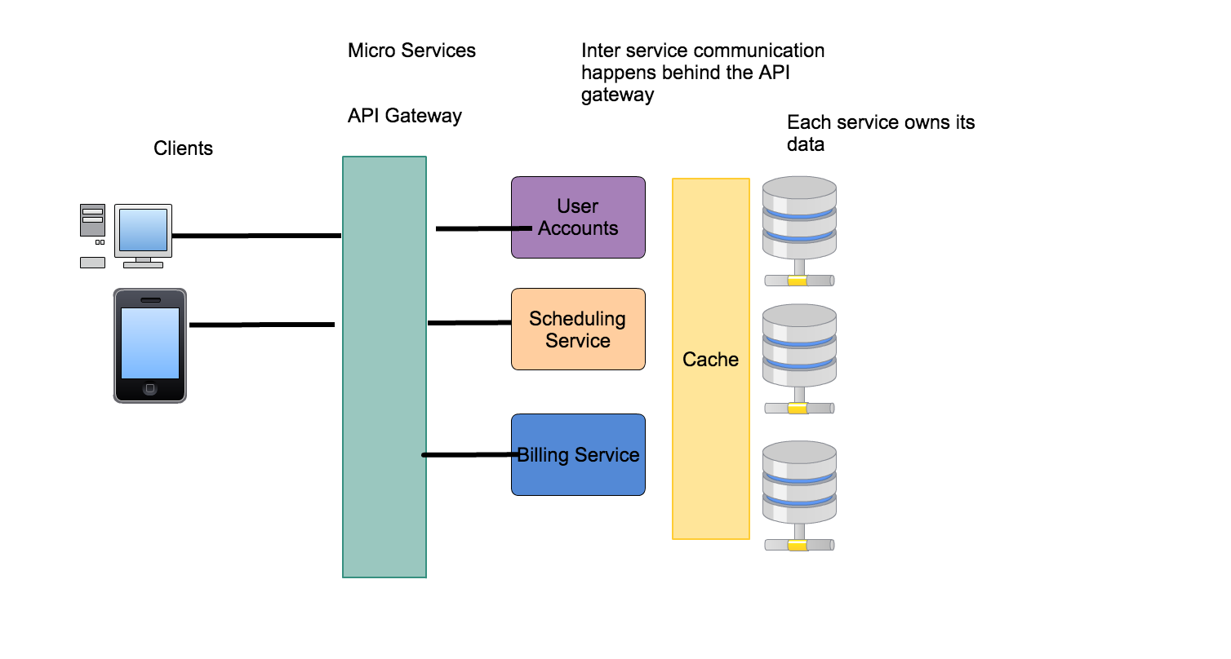
Micro services architecture

Slide 10
Path to Micro services
Advantages
Simplicity
Isolation of problems
Scale up and scale down
Easy deployment
Clear separation of concerns
Heterogeneity and polyglotism

Slide 11
Microservices
Disadvantages
Not a free lunch!
Distributed systems prone to failures
Eventual consistency
More effort in terms of deployments, release managements
Challenges in testing the various services evolving independently, regression tests etc

Slide 12
Resilient system
Processes transactions, even when there are transient impulses, persistent stresses
Functions even when there are component failures disrupting normal processing
Accepts failures will happen
Designs for crumple zones

Slide 13
Kinds of failures
Challenges at scale
Integration point failures
Network errors
Semantic errors.
Slow responses
Outright hang
GC issues

Slide 14
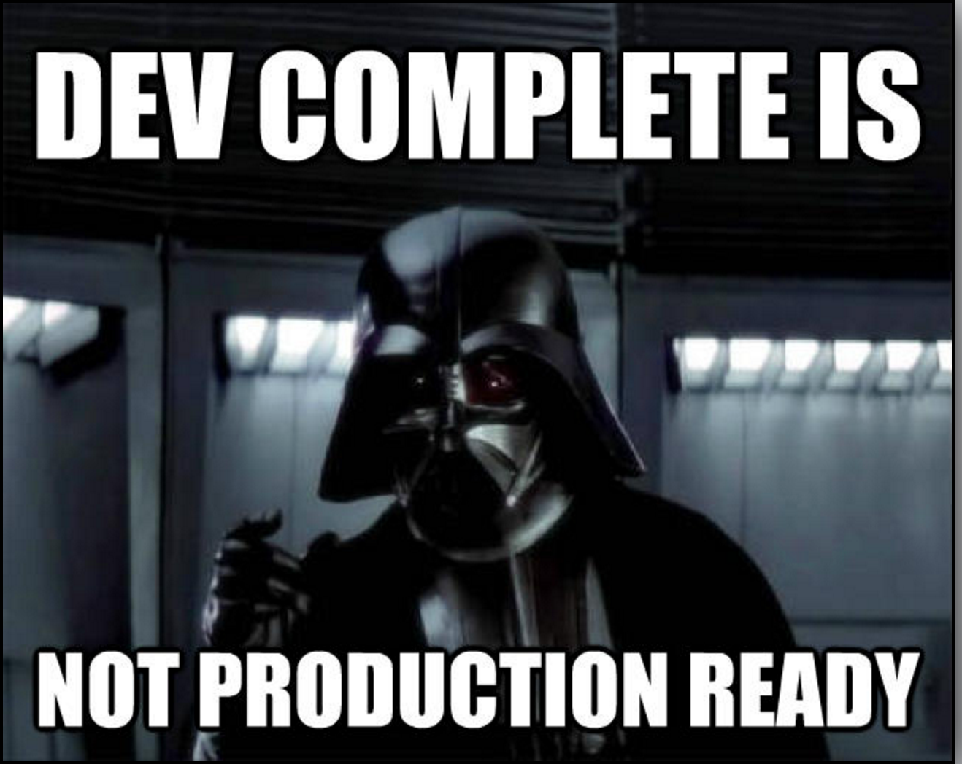
Notes:
I find your lack of faith disturning

Slide 15
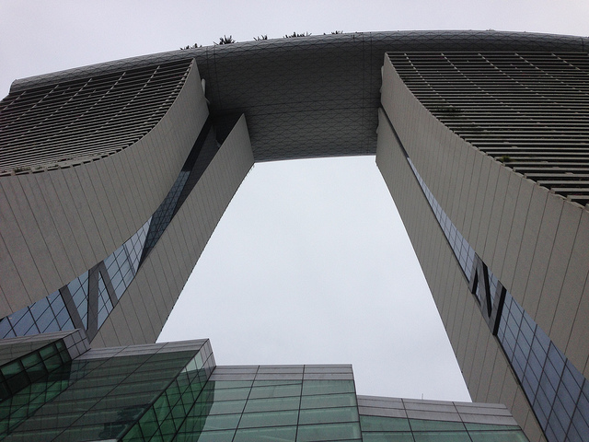
Challenges at scale

Slide 16
Anticipate failures at scale
Anticipate growth
Design for next order of magnitude
Design for 10x plan to rewrite for 100x

Slide 17
Resiliency planning Stage 1
When developing code
Avoiding Cascading failures
Circuit breaker
Timeouts
Retry
Bulkhead
Cache optimizations
Avoid malicious clients
Rate limiting

Slide 18
Resiliency planning Stage 2
Planning for dealing with failures before deploy
load test
a/b test
longevity

Slide 19
Resiliency planning Stage 3
Watching out for failures after deploy
health check
metrics

Slide 20
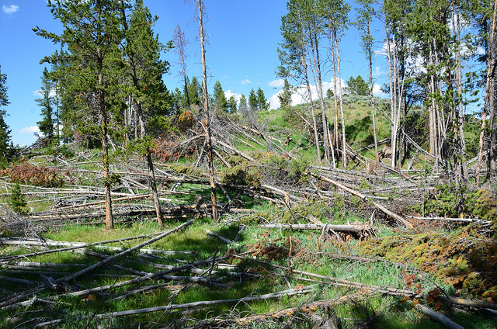
Cascading failures

Slide 21
Cascading failures
Caused by Chain reactions
For example
One node in a load balance group fails
Others need to pick up work
Eventually performance can degenerate

Slide 22
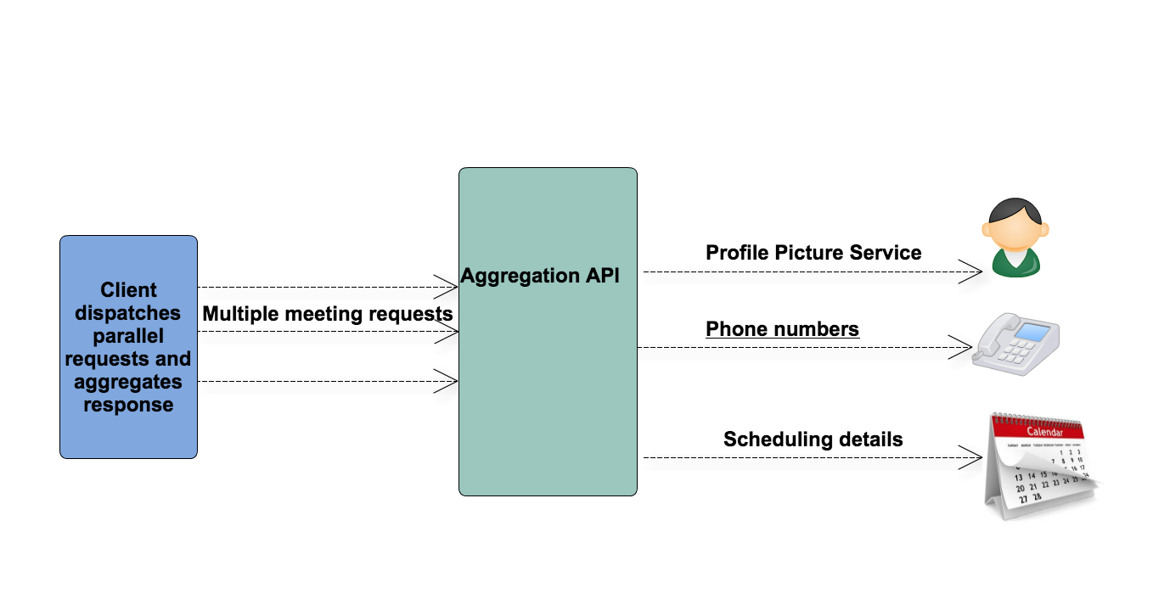
Cascading failures with aggregation

Slide 23
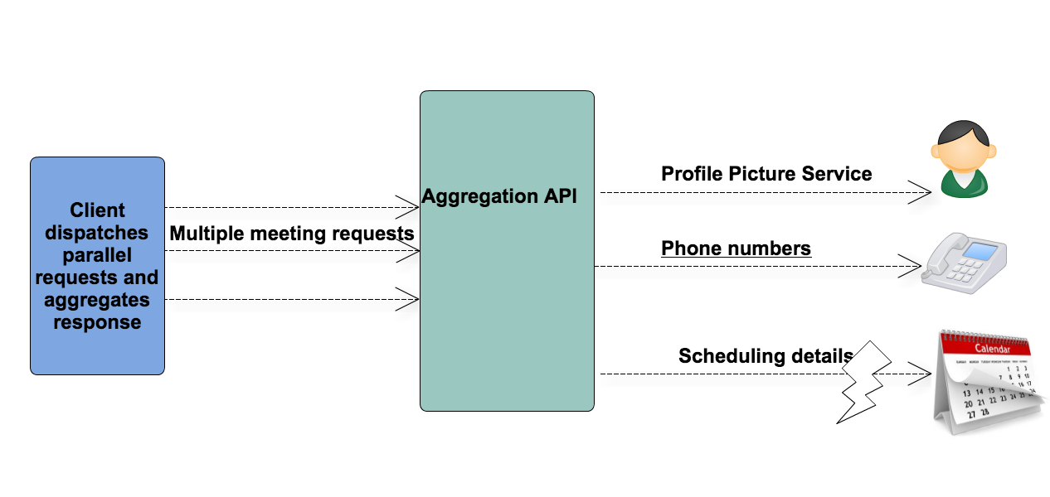
Cascading failure with aggregation

Slide 24

Timeouts pattern

Slide 25
Timeouts
Clients may prefer a response
failure
success
job queued for later
All aggregation requests to microservices should have reasonable timeouts set

Slide 26
Types of Timeouts
Connection timeout
Max time before connection can be established or Error
Socket timeout
Max time of inactivity between two packets once connection is established

Slide 27
Timeouts pattern
Timeouts + Retries go together
Transient failures can be remedied with fast retries
However problems in network can last for a while so probability of retries failing

Slide 28
Timeouts in code
In JAX-RS
Client client = ClientBuilder.newClient(); client.property(ClientProperties.CONNECT_TIMEOUT, 5000); client.property(ClientProperties.READ_TIMEOUT, 5000)

Slide 29
Retry pattern
Retry for failures in case of network failures, timeouts or server errors
Helps transient network errors such as dropped connections or server fail over

Slide 30
Retry pattern
If one of the services is slow or malfunctioning and other services keep retrying then the problem becomes worse
Solution
Exponential backoff
Circuit breaker pattern
Notes:
Apache HttpClient and other network clients implement some stability features out of the box. For instance, the client might execute retries internally under some circumstances. This strategy helps to handle transient network errors such as dropped connections or server failovers. Retrying will not help in the case of permanent errors, however. In this case retrying wastes resource and time on both the client and server side

Slide 31
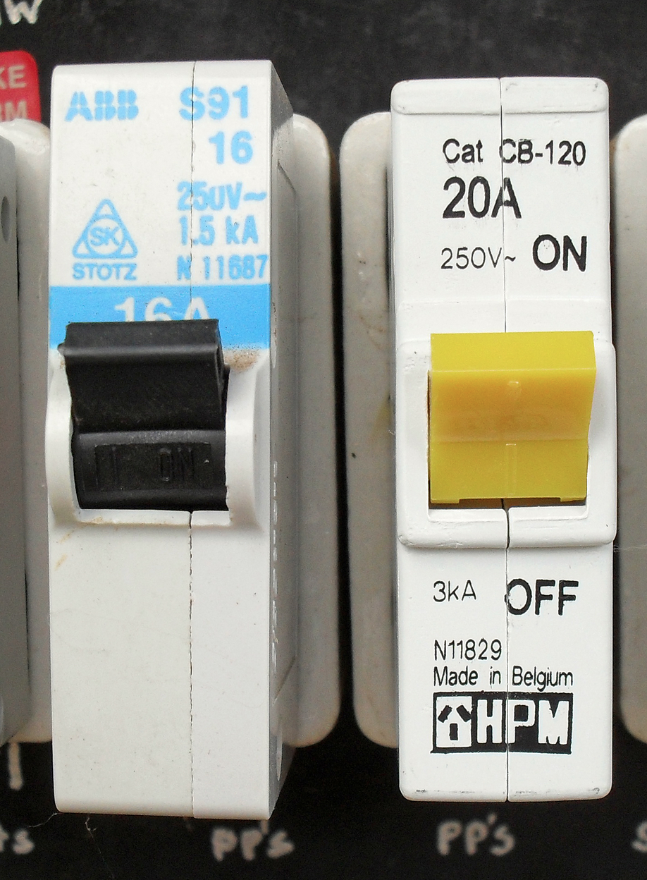
Circuit breaker pattern
Circuit breaker A circuit breaker is an electrical device used in an electrical panel that monitors and controls the amount of amperes (amps) being sent through

Slide 32
Circuit breaker pattern
Safety device
If a power surge occurs in the electrical wiring, the breaker will trip.
Flips from “On” to “Off” and shuts electrical power from that breaker

Slide 33
Circuit breaker
Netflix Hystrix follows circuit breaker pattern
If a service’s error rate exceeds a threshold it will trip the circuit breaker and block the requests for a specific period of time

Slide 34
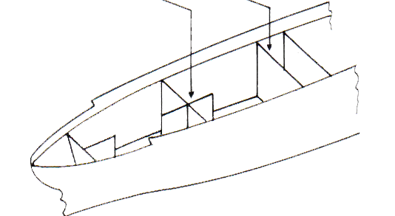
Bulkhead

Slide 35
Bulkhead
Avoiding chain reactions by isolating failures
Helps prevent cascading failures

Slide 36
Bulkhead
An example of bulkhead could be isolating the database dependencies per service
Similarly other infrastructure components can be isolated such as cache infrastructure

Slide 37
Rate Limiting
Restricting the number of requests that can be made by a client
Client can be identified based on the access token used
Additionally clients can be identified based on IP address

Slide 38
Rate Limiting
With JAX-RS Rate limiting can be implemented as a filter
This filter can check the access count for a client and if within limit accept the request
Else throw a 429 Error
Code at https://github.com/bhakti-mehta/samples/tree/master/ratelimiting

Slide 39
Cache optimizations
Stores response information related to requests in a temporary storage for a specific period of time
Ensures that server is not burdened processing those requests in future when responses can be fulfilled from the cache

Slide 40

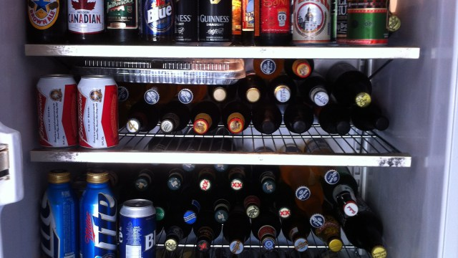


Cache optimizations
Getting from first level cache
Getting from second
level cache
Getting from the DB

Slide 41
Dealing with latencies in response
Have a timeout for the aggregation service
Dispatch requests in parallel and collect responses
Associate a priority with all the responses collected

Slide 42
Handling partial failures best practices
One service calls another which can be slow or unavailable
Never block indefinitely waiting for the service
Try to return partial results
Provide a caching layer and return cached data

Slide 43
Asynchronous Patterns
Pattern to deal with long running jobs
Some resources may take longer time to provide results
Not needing client to wait for the response

Slide 44
Reactive programming model
Use reactive programming such as CompletableFuture in Java 8, ListenableFuture
Rx Java

Slide 45
Asynchronous API
Reactive patterns
Message Passing
Akka actor model
Message queues
Communication between services via shared message queues
Websockets

Slide 46
Logging
Complex distributed systems introduce many points of failure
Logging helps link events/transactions between various components that make an application or a business service
ELK stack
Splunk, syslog
Loggly
LogEntries

Slide 47
Logging best practices
Include detailed, consistent pattern across service logs
Obfuscate sensitive data
Identify caller or initiator as part of logs
Do not log payloads by default

Slide 48
Best practices when designing APIs for mobile clients
Avoid chattiness
Use aggregator pattern

Slide 49
Resilience planning Stage 2
Before deploy
Load testing
Longevity testing
Capacity planning

Slide 50
Load testing
Ensure that you test for load on APIs
Jmeter
Plan for longevity testing

Slide 51
Capacity Planning
Anticipate growth
Design for handling exponential growth

Slide 52
Resilience planning Stage 3
After deploy
Health check
Metrics
Phased rollout of features

Slide 53

Health Check

Slide 54
Health Check
Memory
CPU
Threads
Error rate
If any of the checks exceed a threshold send alert

Slide 55

Metrics

Slide 56
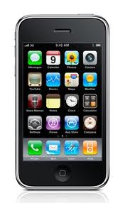
Monitoring
Production Environment
Monitoring server
CHECKS
ALERTS
Email

Slide 57
Monitoring Stack
Application
Log Aggregation framework
OS / Application Code
Newrelic (Java, Python)
Network, Server
Collectd / Graphite
Icinga Healthchecks

Slide 58
Metrics
Response times, throughput
Identify slow running DB queries
GC rate and pause duration
Garbage collection can cause slow responses
Monitor unusual activity
Third party library metrics
For example Couchbase hits
atop

Slide 59
Metrics
Load average
Uptime
Log sizes

Slide 60
Rollout of new features
Phasing rollout of new features
Have a way to turn features off if not behaving as expected
Alerts and more alerts!

Slide 61
Real time examples
Netflix's Simian Army induces failures of services and even datacenters during the working day to test both the application's resilience and monitoring.
Latency Monkey to simulate slow running requests
Wiremock to mock services
Saboteur to create deliberate network mayhem

Slide 62
Takeaway
Inevitability of failures
Expect systems will fail
Failure prevention

Slide 63


Slide 64
References
https://commons.wikimedia.org/wiki/File:Bulkhead_PSF.png
https://en.wikipedia.org/wiki/Circuit_breaker#/media/File:Four_1_pole_circuit_breakers_fitted_in_a_meter_box.jpg
https://www.flickr.com/photos/skynoir/ Beer in hand: skynoir/Flickr/Creative Commons License

Slide 65
Questions
Twitter: @bhakti_mehta
Email: bhakti@bluejeans.com

